Slide 1
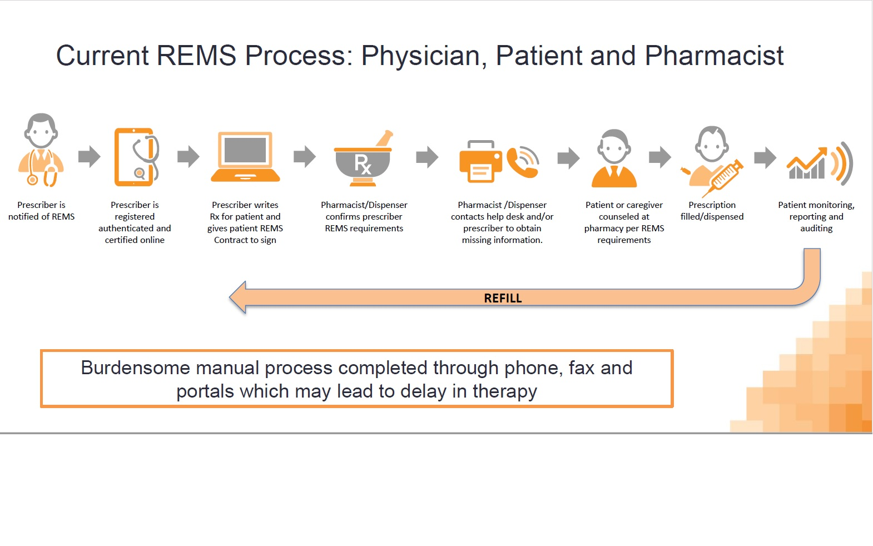
Provider Enrollment
Start of Therapy
Provide
Contact
Information
Review
Patient
Chart
Prescriber Enrollment *
Complete
Training
Perform
Diagnostics *
Patient
Interaction
Determine
Therapy
* for individual REMS drug
Agree to
ETASU *
Activities
Provide
Administrator
With Info *
* ETASU = Elements to Assure Safe Use
* varies per REMS drug
Patient Education
Ongoing Therapy
Enroll
Patient in
REMS
Complete
Patient REMS
Requirements *
Finalize
Prescription
Send to
Pharmacy
Monitor
and Report
Treatment Status
Prescribe
Subsequent
Order(s)
Capture
REMS Info
In Chart
Dispense, Administer *
* may involve other fulfilling parties
* varies per REMS drug

